Slide 1

Building Information
Visualize data of important buildings in Big City in USA
Angela Shi

Slide 2

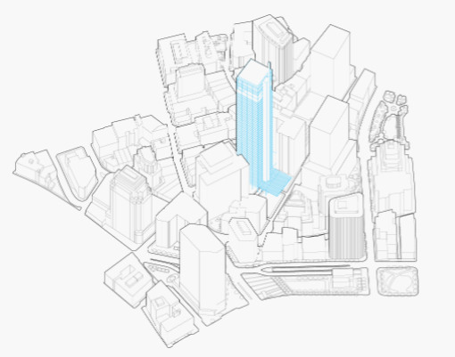
Map Information for different City

Slide 3
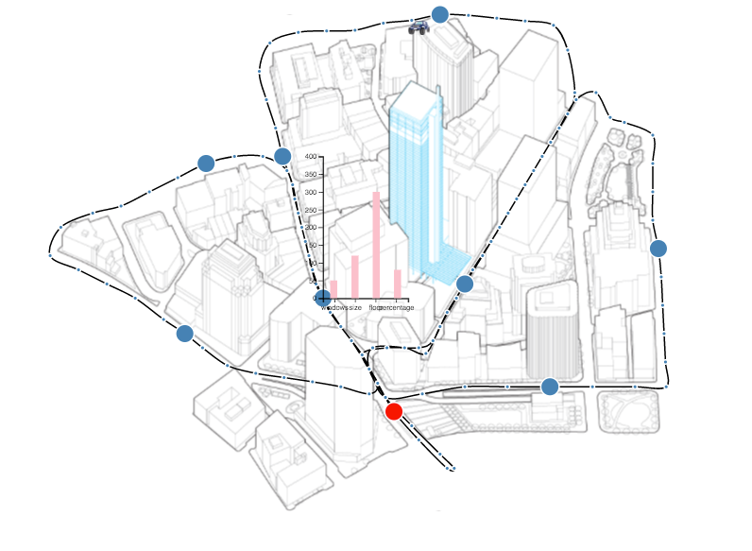
Data Set of Buildings
Built Time
Site Area
Floor
Gross Area

Slide 4
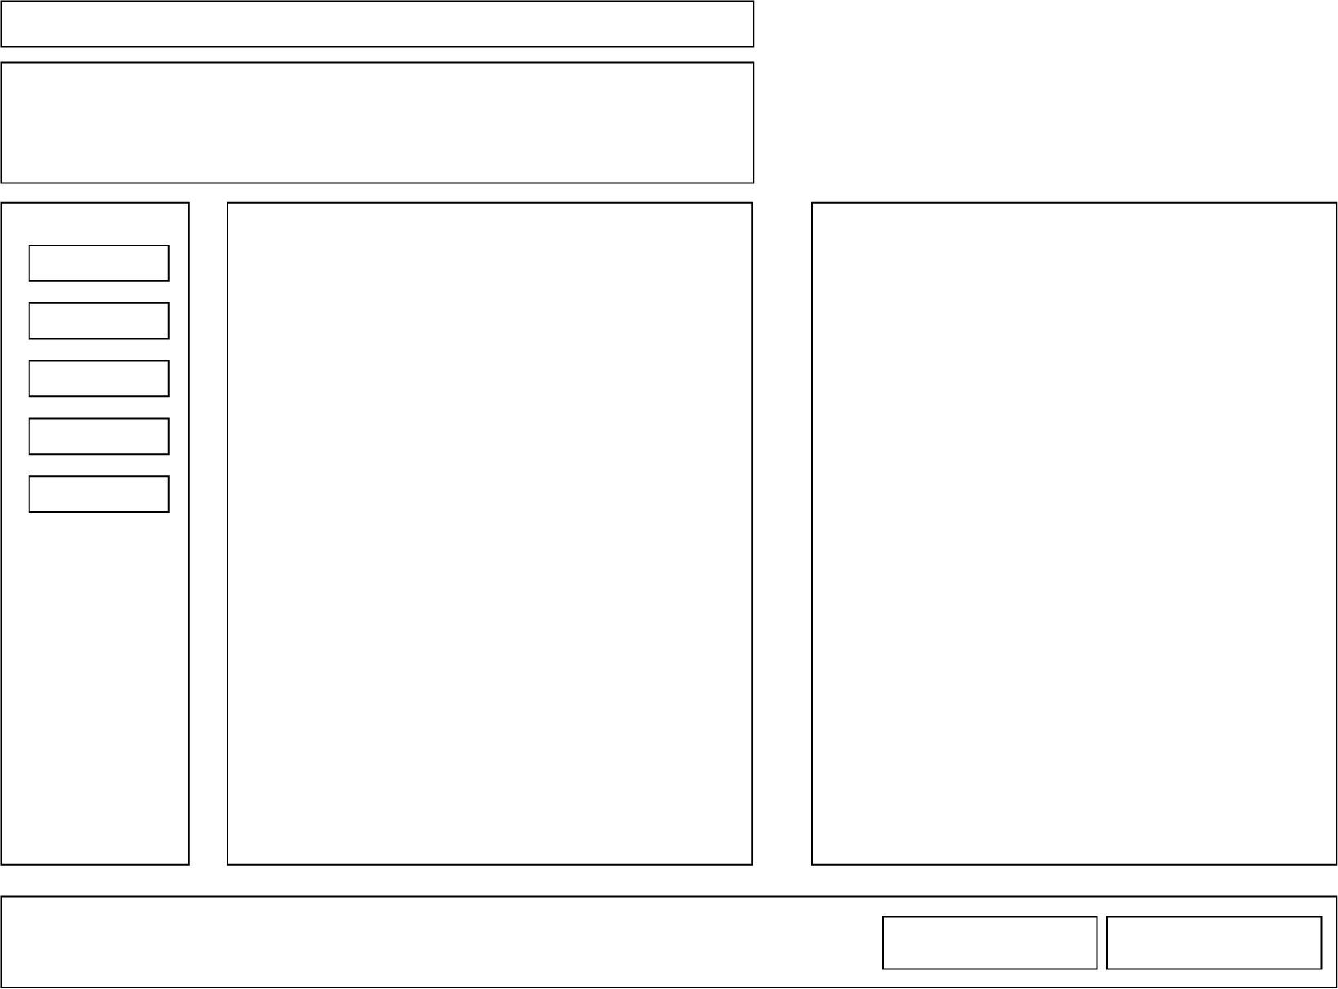
Layout of Final Project
Title
Description of the project
Select column
Boston
New York
Chicago
Los Angels
Phoenix
Seattle
Map: maps for each city
Districts drawing with information
Comparison button

Slide 5
Summary
Problems
Maps of different cities
How to auto scale of the scale of map -> have no idea about it now, cause when the screen size changes, the map can’t fit
the size of SVG
Working process
Layout of the page -> HTML
Set the format of title, body text of page -> CSS
Fit City map to left SVG element -> d3.js, javascript
Click function to Zoom in
Tooltip to show district basic information
Draw points of different districts on the map -> longitude, latitude data for these points
Axon drawings for each district -> pattern
Action dots for typical buildings -> positions of dots on the drawing
Mouse events on dots, show information of single building-> tooltips
Button click function, show comparison data of buildings in this district -> bar chart
Choose other city, …

